Slide 1
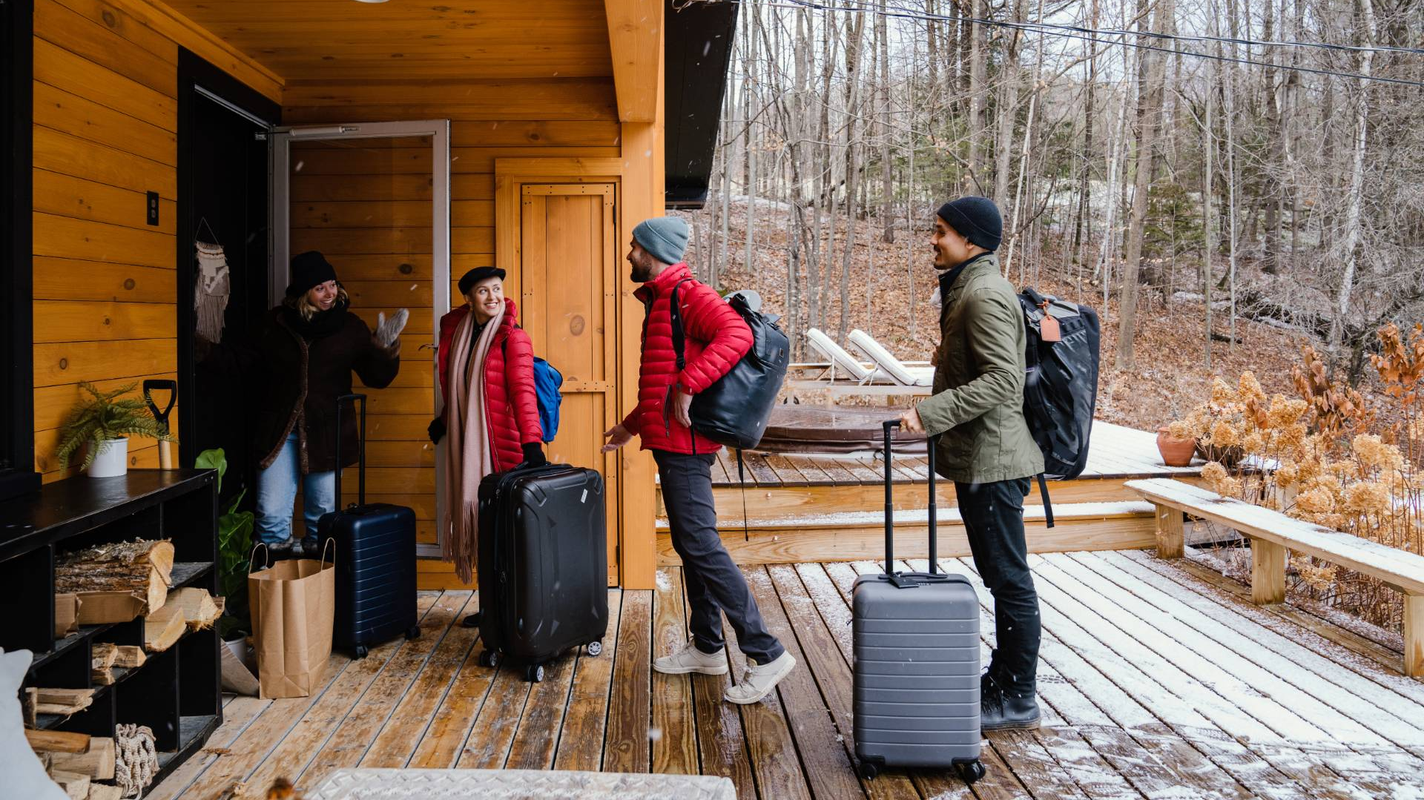

Airbnb Inc
Will, Tessie, Kipp, Thayer, Leo, Aynura

Slide 2

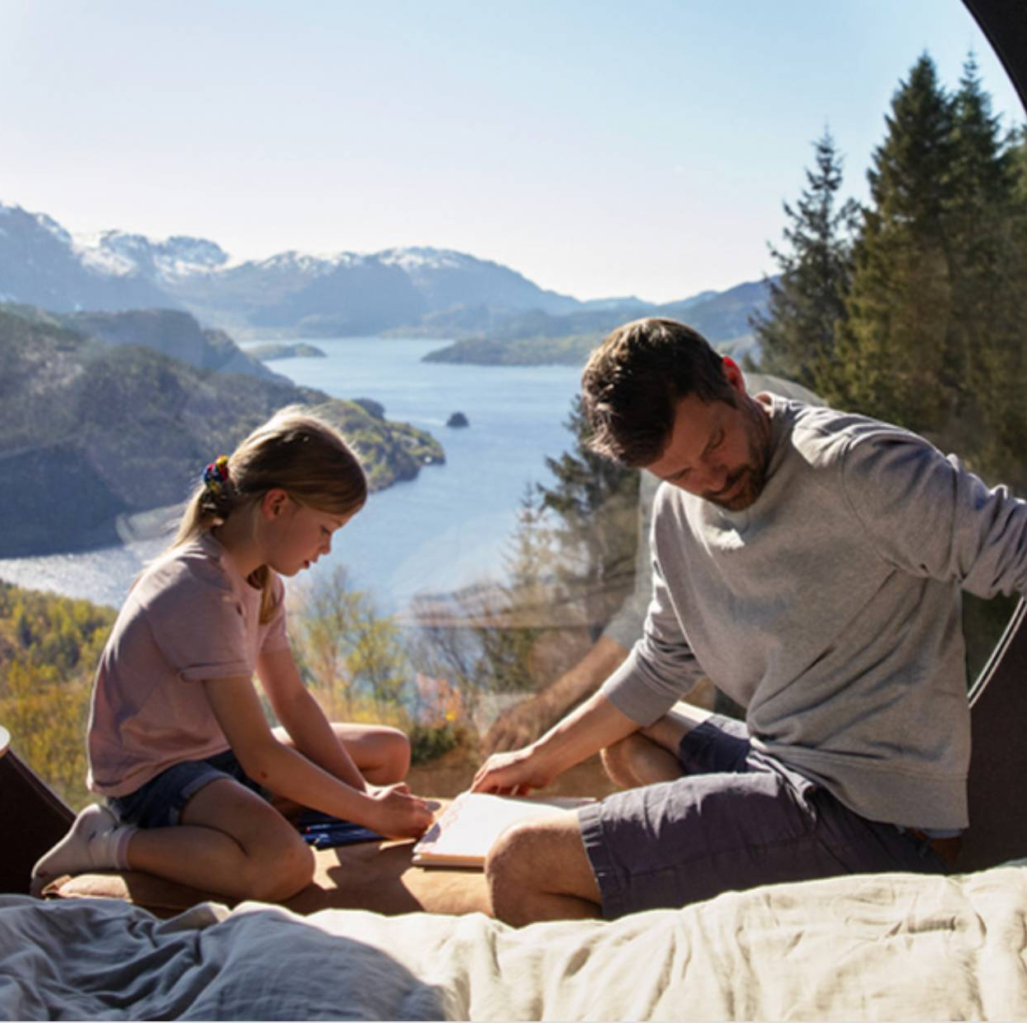
Executive Summary
What is Airbnb?
Economics
Marketing
Strategy

Slide 3
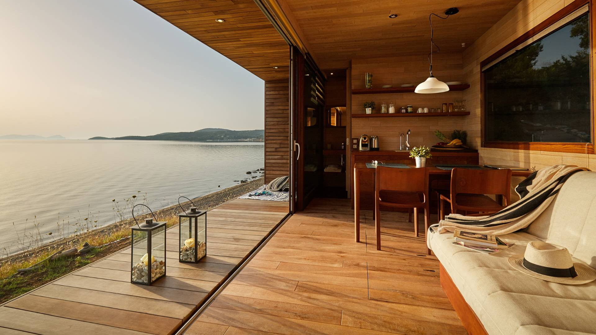
Airbnb Analysis
Airbnb is an online marketplace that connects property owners (labelled as "hosts" in its app), with travelers seeking short-term accommodations, typically for vacation.
Instead of booking a traditional hotel or hostel, guests can book spaces directly from locals, delivering an experience similar to how locals in the area live.
Airbnb operates as a two-sided digital marketplace, generating revenue primarily through charging commission fees on completed bookings.
Guest service fees –14%-16.5%
Host service fees – 3%

Slide 4
Economics
Account | Value (In Millions of Dollars – 2025)
Revenue | 12,241
Cost of Revenue (COGS) | 2,086
Capital Expenditures | 33
Net Working Capital | 331
SG&A (Selling General & Administrative) | 1,234
Expenses | 6,269
Profit Margin (%) | 20.5%
More demand for travel -> 13% in 2026 and 12% in 2027 ↑
Experience economy: booking support for users ↑
Cities are making rules to shorten rentals ↓

Slide 5


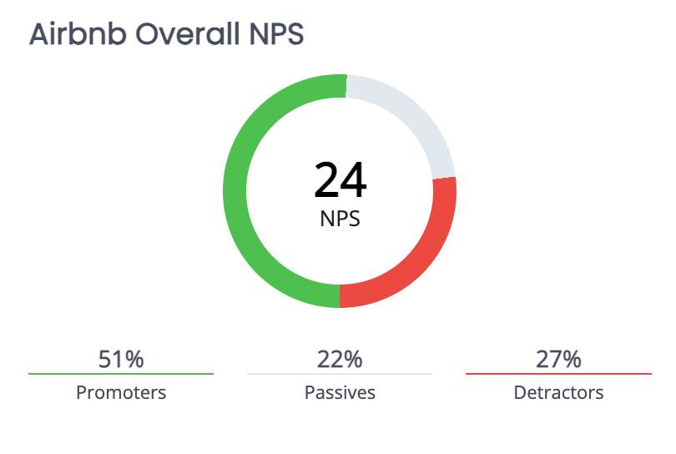




Marketing
High Local Immersion
Broad Offerings
Brand Equity: Strong brand recognition, high trust and reputation.
Loyalty: First look but consumers will follow lower prices
Awareness: Rental called "Airbnbs" - genericization.
Perceived Value: More expensive, more options, worth the price
Associations: "experiences", trust, reliability, safety

Slide 6
PESTLE
Airbnb offers low-cost rentals for people who're seeking local experiences
Airbnb functions as website and app, more service-based system
Airbnb seeks to build relationships between hosts and visitors
Driver | Cost (supply) | WTP (demand)
Political | Government restrictions (zoning laws) that will affect Airbnb's operations & growth | Tourism-promoting government policies
Economic | Inflation, tariffs, foreign currency fluctuations Dependent in general on the well-being of the overall economy and certain industries | Higher labor, technology, compliance costs would increase Airbnb's operating costs, changing consumer ability to pay
Social/cultural | Global migration Collaboration with big events, like the FIFA World Cup, across countries and regions Middle-class wanting to avoid tourist trap | Consumer preference (ex. Preference for unique destinations with no hotel availability) Increase in remote work also increases travel
Technology | Dependence on digital platforms (mobile and website), relying on technology to connect hosts and guests, process payments. Effectively uses technology as a middleman between both parties. | Easy to use interfaces (e.g. searching, comparing, booking, etc.) and its personalized recommendation using AI, raising the willingness to pay.
Legal | Licensing, taxes, regulations Consumer protection and privacy regulations change
Environment | Climate Change Natural disasters (forest fires, hurricanes) Extreme Weather | Climate Change Natural disasters (forest fires, hurricanes) Extreme Weather Carbon footprint reduction

